Slide 1
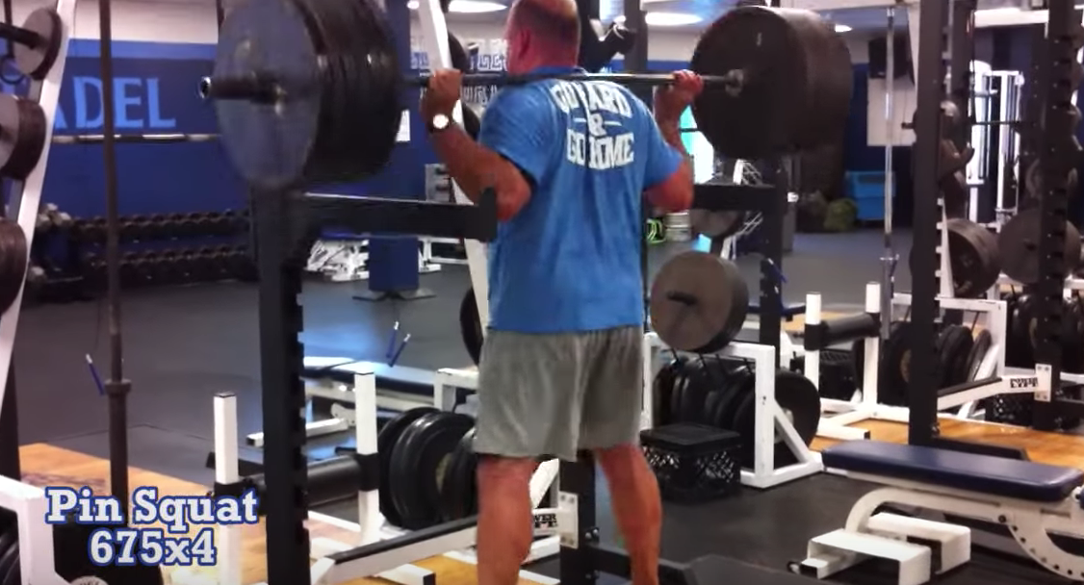
Strength & Conditioning
By Adam Nelson

Slide 2
Key Influencers – In Strength
Charles Poliquin
Cal Dietz
Eric Cressey
Joe Kenn
Louie Simmons
Chad Smith
Dan John
A. Bondarchuk

Slide 3
Set a Standard
Would you allow your athletes to continue training with poor technique without intervening?
Would you allow them lift, run or jump with poor technique?
How do we change the direction of our program?
PILLARS

Slide 4
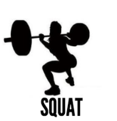
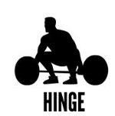

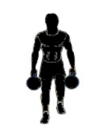

Key Movements

Slide 5
HINGE
Neutral Spine
Big Chest
Vertical Shins
Weight on Heels

Slide 6
Squat
Packed Shoulders
Stable Core
Chest Up
Knees Out

Slide 7
PRESS
Whole Body Tension
Packed Shoulders
Shoulder Width Grip
Pull the Bar to the Chest

Slide 8
Pull
Scapular Retraction

Slide 9
Carry
Braced Core
Neutral Spine
Shoulder Packed
“The Core is the Ultimate Power Transducer”

Slide 10
Additional Learnings
You don’t need to be an expert, but you do need to know enough to know the experts.

Slide 11
Programming Overview
What do you want to accomplish and when do you want to accomplish it?

Slide 12
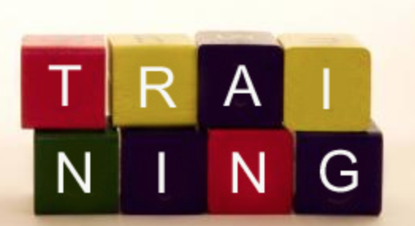
Phases in Successful Training Programs
Aerobic Block
General Preparation
Accumulation Phases
Intensification Phases
Peaking Phases
Notes:
I differentiate between aerobic block and GPP only in the nature of the workouts. My aerobic block workouts are dictated by the clock and once I begin my GPP it’s more set and reps based.

Slide 13
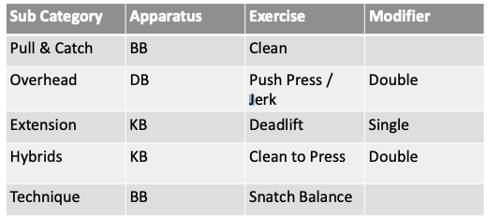
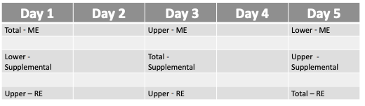
Tips to Optimizing Your Programming
Identify and Categorize all the exercises you can do in your gym.
Create weekly training plan that works for your schedule.

Slide 14
PLUG AND CHUG

Slide 15
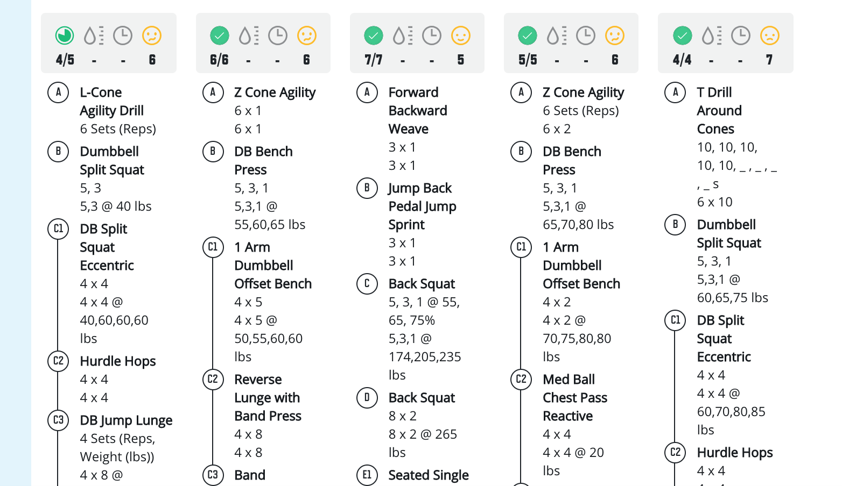
Program your Workouts
Paper
White Boards
Excel
TrainHeroic

Slide 16
Aerobic Block Training
Escalating Density Workouts
  Dan John EMOM Workout
  Cal Dietz Paired Workouts
Contralateral Timed Workouts
  Cal Dietz
Note: The image links to a presentation by Cal Dietz. The Paired Workouts links to a sample on a separate site.

Slide 17
My Default Program Structure

Slide 18
Peaking Outline

Slide 19
Training Theories
Linear
Undulating
Specificity
Velocity Based
They all work.

Slide 20
Closing
Do you what you know.
A “Bad” program believed in or executed well is still pretty good.
All the information you need is at your fingertips.

